Slide 1
Understand monitoring and reporting options in Azure

Slide 2
Executive summary
Purpose
Layout
Style
The executive summary should be a brief, stand-alone version of a document that focuses on the most important messages, meant to be read rather than presented.
Do not include any content that is not in the body of the document.
Use the columns in this layout to organize the content.
If you need more than 3 columns, use two rows or add a second page.
Be brief. Write the shortest, simplest sentences possible.
Favor active over passive verbs.
Use plain words and the client’s terminology, not consulting jargon.
Source: …

Slide 3
Agenda
Azure Monitor
Azure Service Health

Slide 4
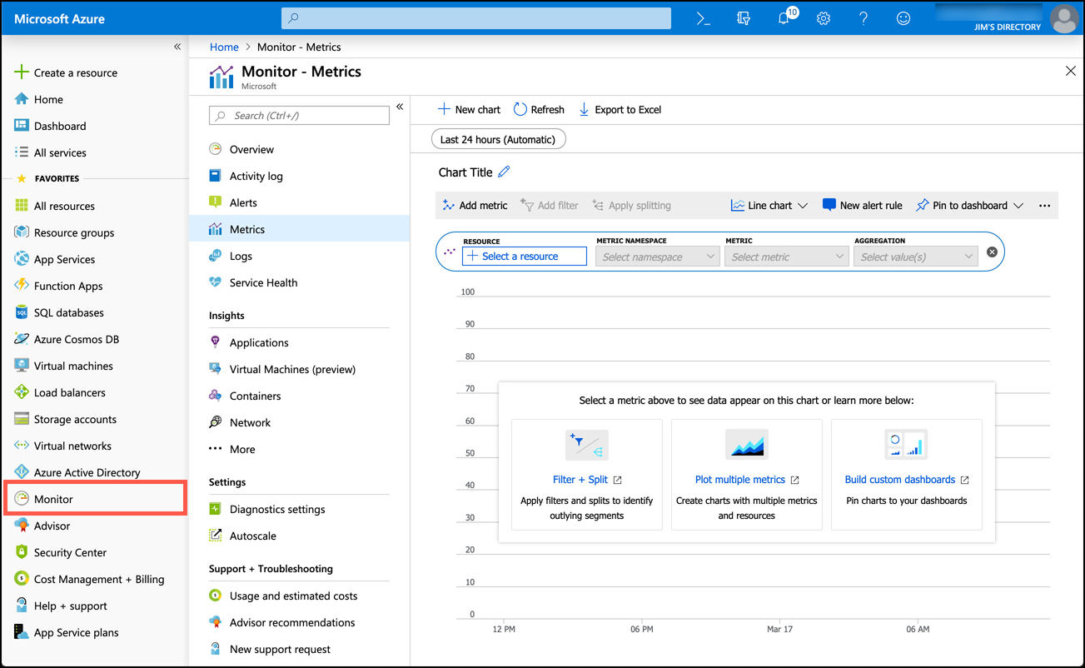
Azure Monitor
Azure Monitor aggregates metrics for Azure services and exposes them in a single interface. You can also create alerts that will notify you, or someone else, when there are concerns you might want to address.
To access Azure Monitor, click on Monitor in the Azure portal to display the Azure Monitor blade. Azure Monitor is customizable, so you can see exactly what interests you the most. For that reason, it doesn’t show any metrics until you configure them. To view metrics, click on Metrics and then Select A Resource.

Slide 5
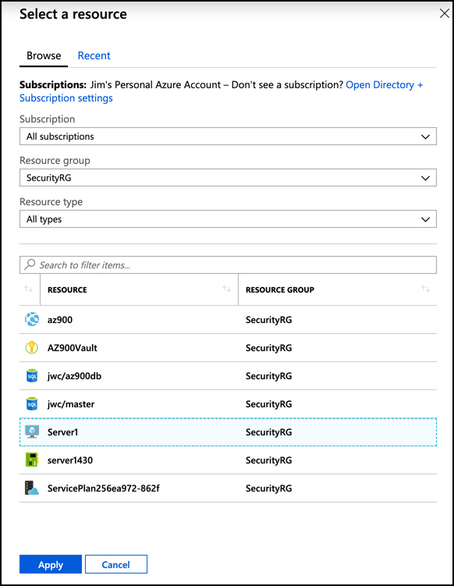
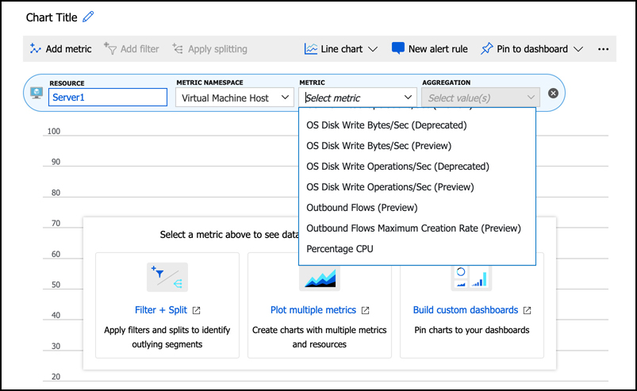
Azure Monitor
Once you select a resource, you are presented with a list of metrics related to that resource.

Slide 6
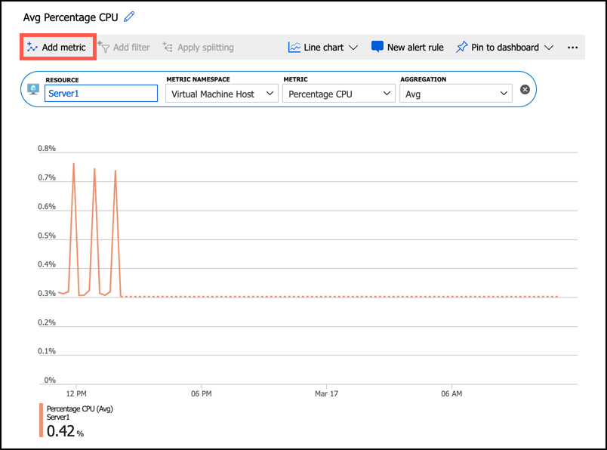
Azure Monitor
As soon as you select a metric, the chart updates to show a graph of that metric. You can add additional metrics to your chart by clicking on Add Metric

Slide 7
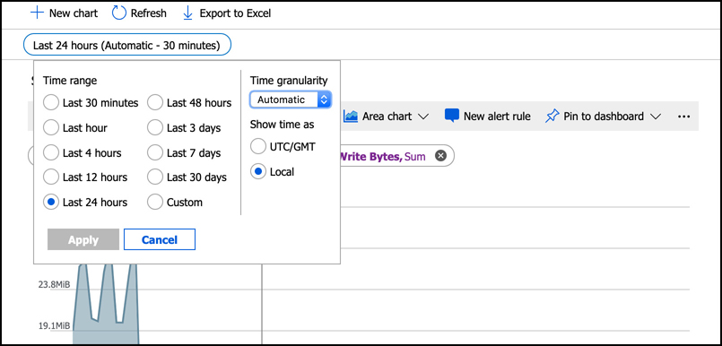
Azure Monitor
By default, charts are shown for the past 24-hour period, and the real-time value is shown at the right edge of the chart. However, you can customize the timeframe that is shown by clicking on the timeframe and adjusting it to what you want to see.

Slide 8
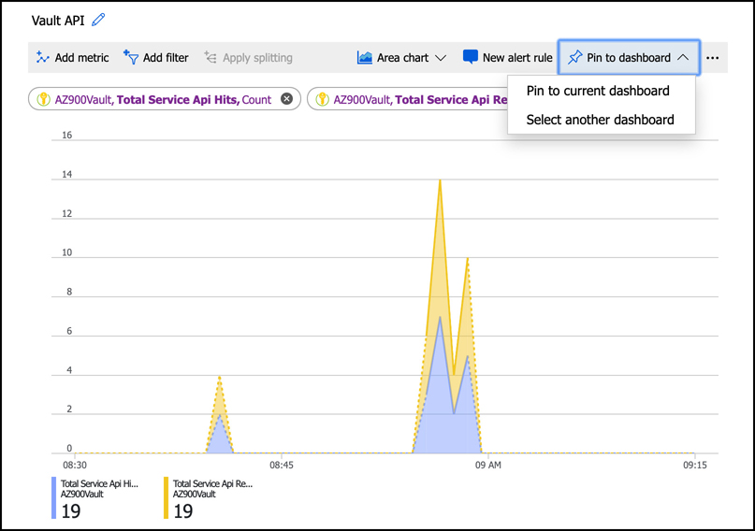
Azure Monitor
Once you have a chart that you find useful, you can pin that chart to the portal dashboard by clicking on Pin To Dashboard.

Slide 9
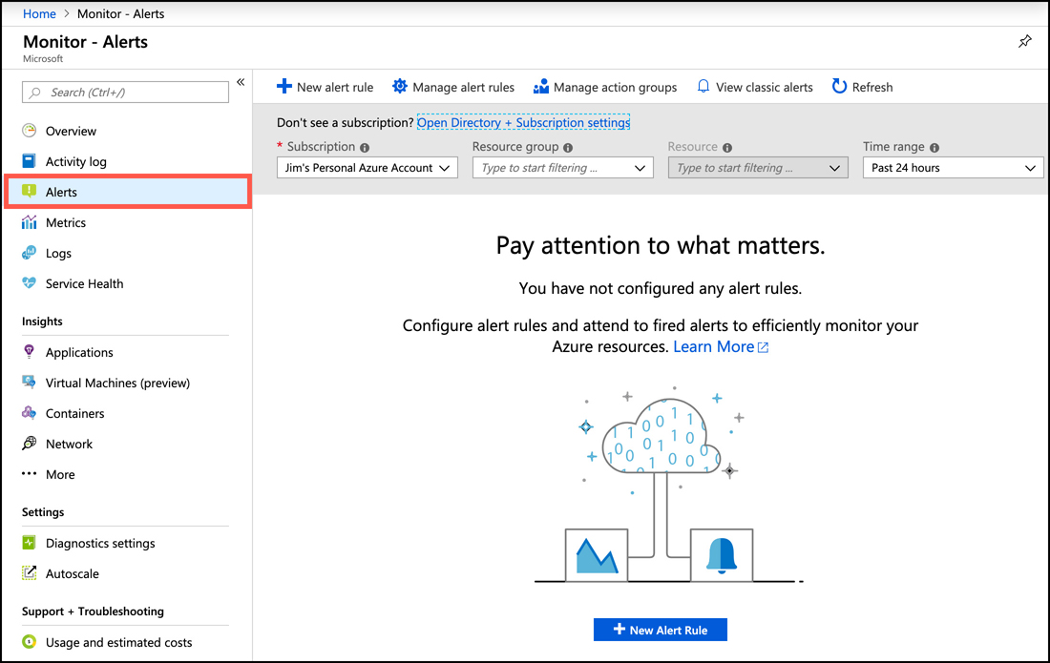
Azure Monitor
Azure Monitor Alerts can notify you or others with email or SMS text message, run a Logic App flow, call a Function App, make a request to a webhook, and more, when a certain condition is met. Alerts are based on rules that you define, and when a rule’s condition is met, an alert performs the action you specify.
You can create an alert rule that is automatically configured for the metrics you’ve selected in your chart by clicking on New Alert Rule at the top of your chart. You can also start from scratch by clicking on Alerts in the menu for Azure Monitor, and then clicking on New Alert Rule.

Slide 10
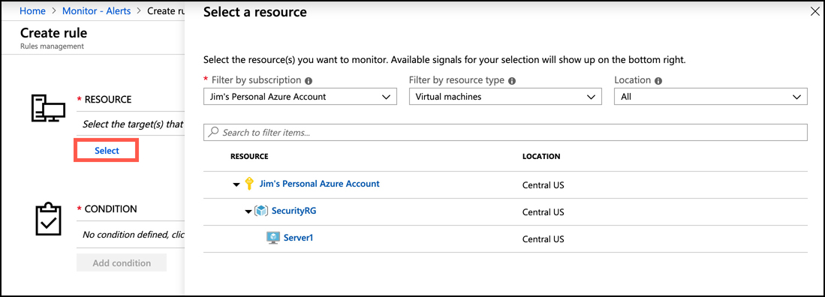
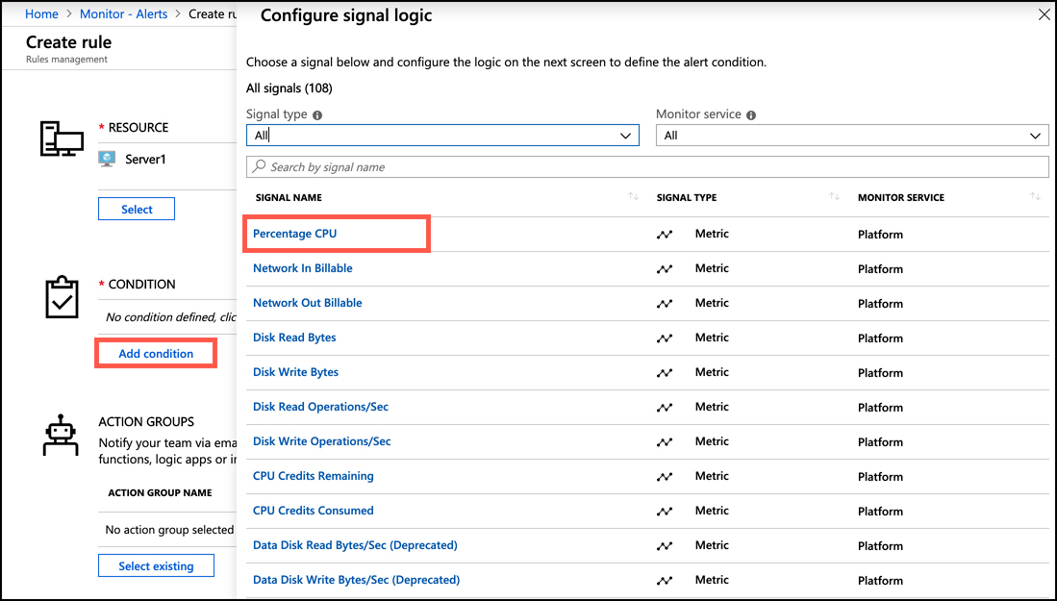
Azure Monitor
To start your rule, click on Select and select the resource you want to configure an alert for.
Next, you’ll need to specify the condition for your alert. Click on Add Condition, and then select the signal you want to monitor for your alert.

Slide 11
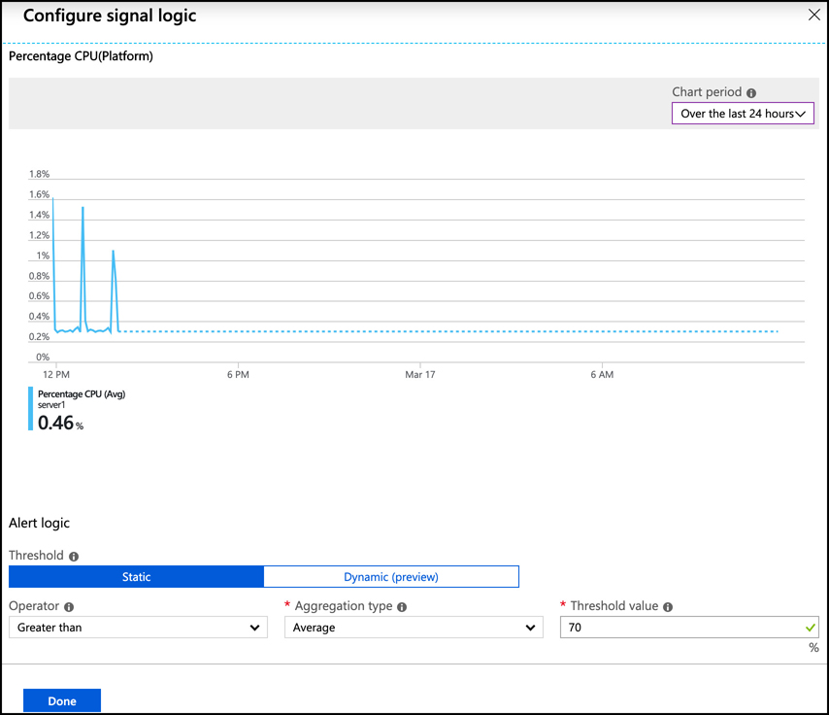
Azure Monitor
Once you select a signal, the logic for the signal is configured.
This shows the last four hours by default, although you can adjust the chart period. You can specify an operator, aggregation type, threshold, and click Done to create the logic for the alert.

Slide 12
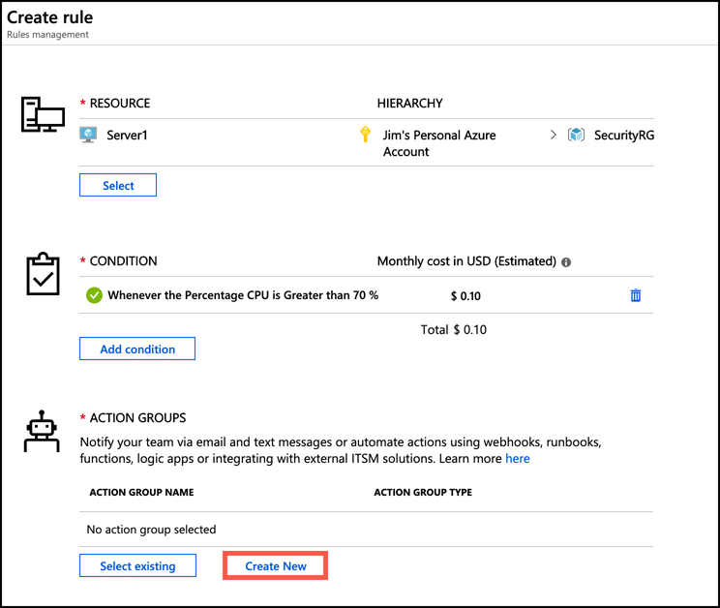
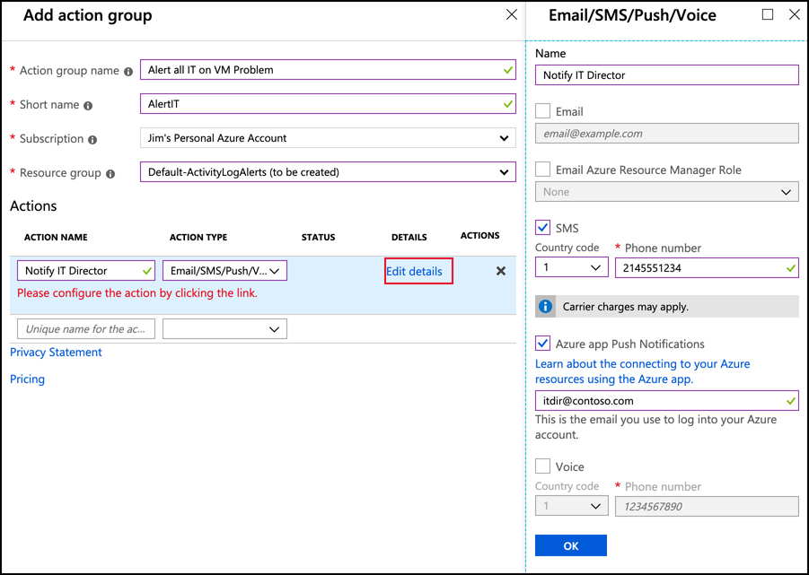
Azure Monitor
When an alert is triggered, it performs an action that you specify using an action group. An action group contains a list of actions to take when an alert is triggered. To create a new action group, click on Create New.

Slide 13
Agenda
Azure Monitor
Azure Service Health

Slide 14
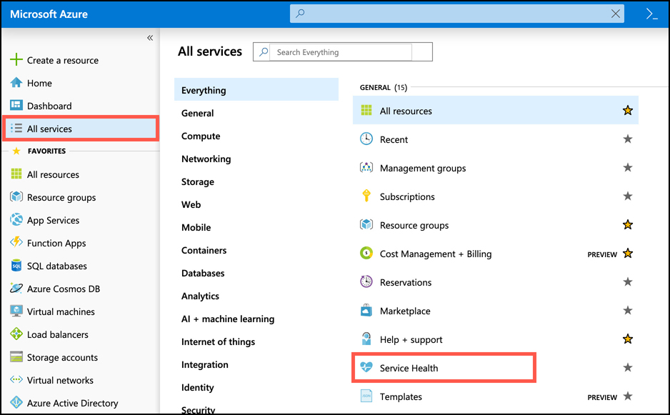
Azure Service Health
Microsoft operates an Azure Status web page where you can view the current status of Azure services in all regions where Azure operates. While it is a helpful view of overall Azure health, the enormous scope of the web page doesn’t make it the most effective way to get an overview of the health of your specific services. Azure Service Health can provide you with a view specific to your resources.
To access Service Health, click All Services, and then click on Service Health.

Slide 15
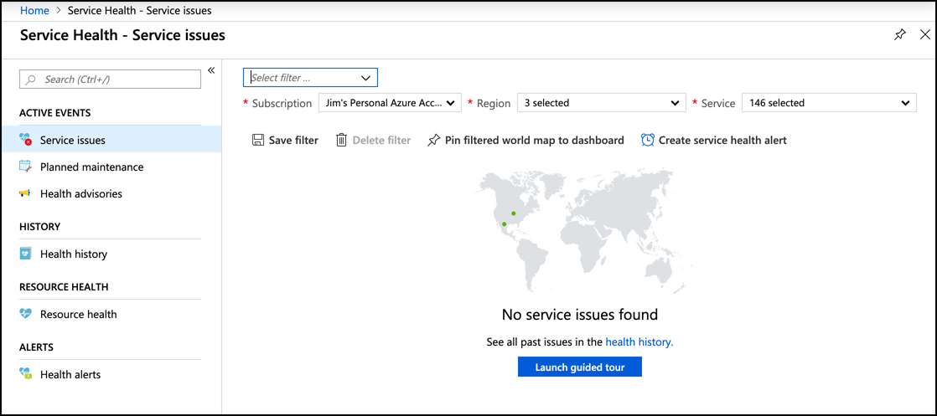
Azure Service Health
The figure shows the Service Health blade showing the health and status of my resources. The map shown has two green dots on it representing the health of the two Azure regions where resources are deployed. This map is specific, and by clicking on Pin Filtered World Map to Dashboard, you can have a quick reference of Azure health for just the regions where you have resources.

Slide 16
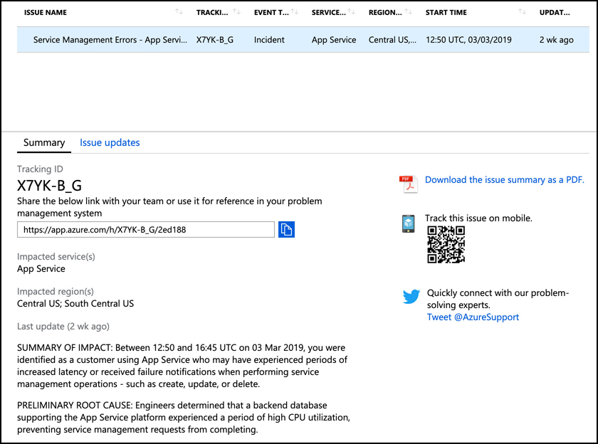
Azure Service Health
You can also view any upcoming planned maintenance that might impact you by clicking on Planned Maintenance. By clicking on Health Advisories, you can see health information that might be related to your own configuration and not a problem somewhere in Azure.
When a service issue is impacting you, you’ll see details on the issue. In addition to full details on the incident, you also have a link that refers to details on the incident. You can also download a PDF that contains an official Microsoft notice of the incident.

